Slide 1

Pushdown Automata
CSCI 265 Lecture 6
By Ariel Avshalom

Slide 2
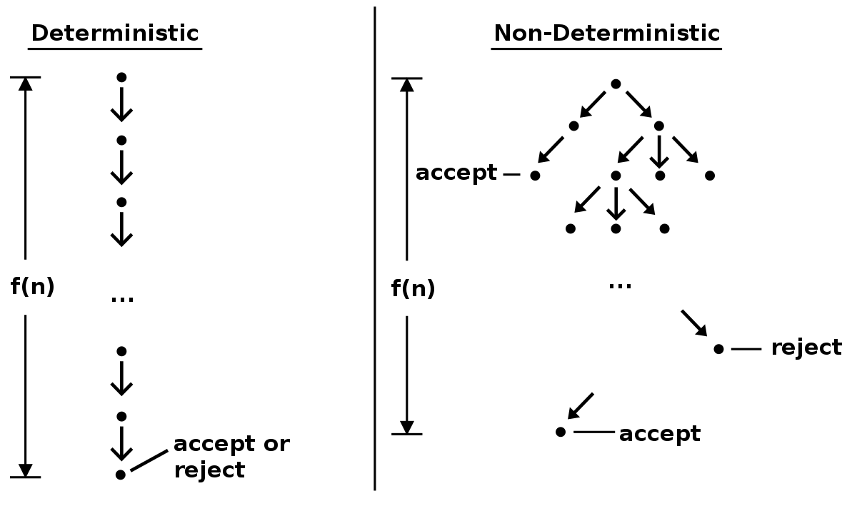
Recall NFAs
An NFA or nondeterministic finite automata is a finite automata which exhibits the properties of nondeterminism

Slide 3
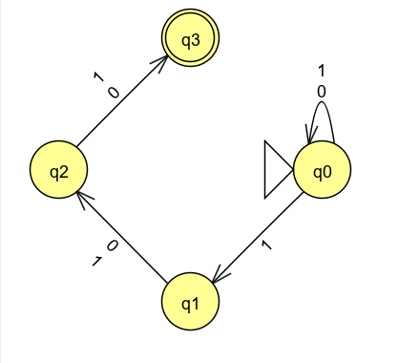
What does this mean?
There are multiple possible paths to follow at each state and transition
When a transition has no path it dies
I.e. there is no garbage state
Look at this example as a refresher:
Let A be the language consisting of all strings over {0,1} containing a 1 in the 3rd position from the end

Slide 4

Formal definition of a NFA
An NFA is defined by the following 5-tuple:
A finite set of states called (Q)
An alphabet (Σ)
A transition function ($δ:Q x Σ_{\text{ε}} →\text{𝒫}(Q)$)
A start state ($q_{0} ∈ Q$)
A set of accepting states ($F \text{⊆} Q$)

Slide 5
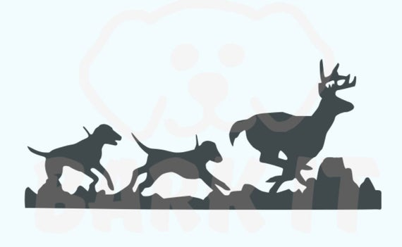
Wait, why are we doing this again?
The reason why its worth recalling NFAs (besides the fact that they’re awesome!) is that
Nondeterminism is a concept that will keep on following us in this class (and throughout computer science)
The next topic we’ll be covering is a fancy version of an NFA
This fancy context-free version of an NFA is called a pushdown automata or PDA
The difference between an NFA and a PDA is that a PDA has a stack

Slide 6

Stacks
Who here has taken a data structures class before?
If you have than you’ve seen stacks
In fact even if you haven’t you’ve probably seen stacks before
So what is a stack?

Slide 7
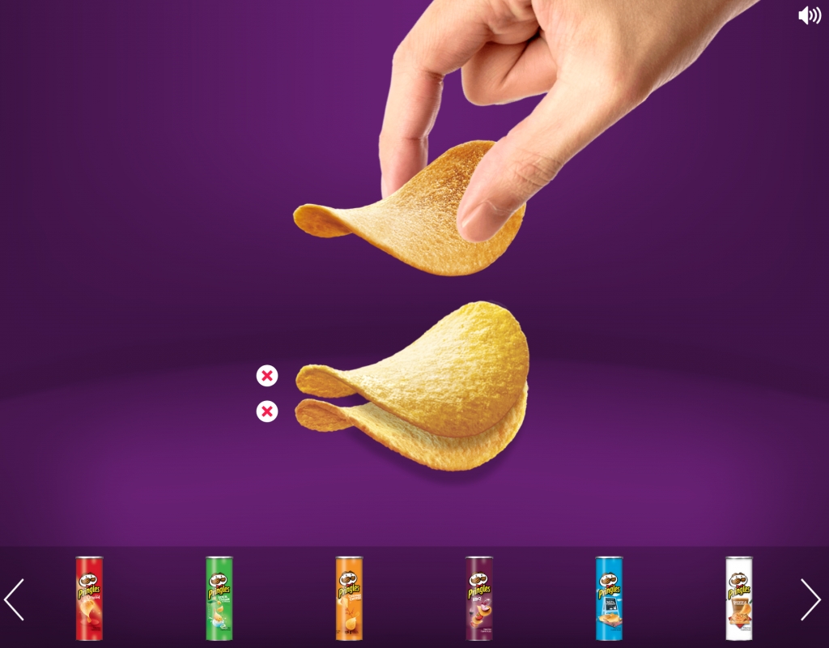

Slide 8
Stacks in data structures
Generally, a stack is an abstract data type which contains a collection of elements
Stacks have two main operations
Push
Pop
Push places an element onto the top of the stack
Pop removes the top element from the stack
Let’s look at one now

Slide 9


How does this work?
A PDA has both a stack and a set of states (with transitions)
This extra element gives us the extra memory necessary to achieve a context-free recognizer
The reason why this memory gives us so much more power is because we now have a way to store what happened earlier
We can achieve a language like $0^{n}1^{n}$
This works by allowing us to push and pop values onto the stack as they appear in the input
A stack can hold an unlimited amount of information

Slide 10

Simulating $0^{n}1^{n}$
In order to get the same number of 0’s and 1’s in our PDA we can initiate a rule where
Whenever we see a zero, we add it to the stack
Whenever we see a 1, we remove a 0 from the stack
If the input is read and the stack is empty, accept the input
Otherwise reject the input

Slide 11
Important note
Just because NFAs and PDAs have something in common in between them does not mean that we are talking about a nondeterministic PDA!
Nondeterministic PDAs recognize things that no deterministic PDA can
Nondeterministic PDAs are useful to us because they are equivalent to CFGs

Slide 12
Anything a (nondeterministic) PDA can do, a CFG can do just as well!

Slide 13
Why is that important?
Since we know that CFGs are context free
meaning that they can recognize nonregular languages
We can extend that to PDAs by showing equivalence
Also, we now have 2 ways to prove that a language is context free
Either create a CFG or a PDA that recognizes it

Slide 14

Formal definition of a PDA
A pushdown automaton is a 6-tuple $\left(Q,Σ, Γ, δ, q_{0}, F\right)$ where $Q,Σ, Γ and F$ are all finite sets and
$$Q is the set of states$$
$$\text{Σ} is the input alphabet$$
$$Γ is the stack alphabet$$
$$δ:Q x Σ_{ε} x Γ_{ε}→\text{𝒫}\text{(}Q x Γ_{ε})$$
$$q_{0}∈Q is the start state$$
$$F \text{⊆} \text{Q} \text{is} \text{the} \text{set} \text{of} \text{accept} \text{states}$$

Slide 15

Examples
We already covered
$$\left\{0^{n}1^{n}\right\}$$
Let’s try:
$$\left\{a^{i}b^{j}c^{k}\right|i,j,k≥0 and i=j or i=k\}$$
$$\left\{ww^{R}\right|w∈{\left\{0,1\right\}}^{∗}\}$$

Slide 16
Equivalence with CFGs
CFGs and nondeterministic pushdown automata are equivalent in power
We will now attempt to show the above statement is true
Namely, CFGs and PDAs can both describe the class of context-free languages
Remember that we defined a context free language (CFL) to be any language that can be described by a CFG
Theorem: A language is context free IFF some pushdown automaton recognizes it

Slide 17
A language is context free IFF some pushdown automaton recognizes it
Notice the IFF (if and only if statement) here
In this case, both proofs have similar difficulty
Left side: If a language is context free then some pushdown automaton recognizes it
Right side: If a pushdown automaton recognizes some language, then it is context free
We will try creating these proofs on OneNote
This means we need to create a proof showing that both sides are true

Slide 18

Construct a PDA from the following CFG
$$S →aTb | b$$
$$T →Ta | ϵ$$

